Slide 1
Australian Aboriginal Music

Slide 2
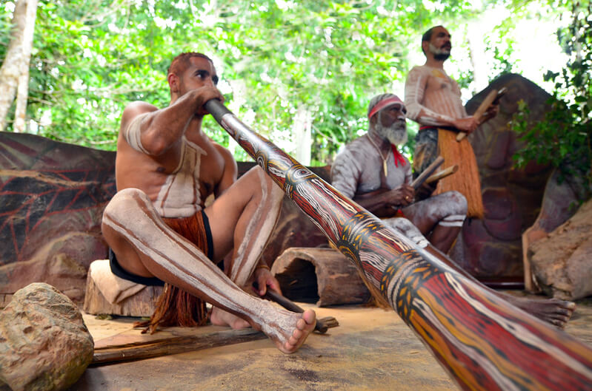
At the end of this lesson you should be able to:
Explain what music is.
Identify how musical instruments are classified.
Describe how three Aboriginal instruments create music.

Slide 3
There is a strong connection between Australian Aboriginal culture and music.
For thousands of years, Aboriginal people have relied on music and word of mouth rather than written language to pass on their stories and knowledge.
Music teaches Aboriginal people about their culture, their natural environment and their place in the world.

Slide 4
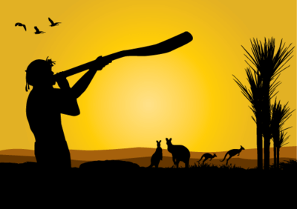
Aboriginal people use music to sustain and pass on their culture and way of life.
In this Smart Lesson, you will learn how traditional Australian Aboriginal instruments create music.

Slide 5
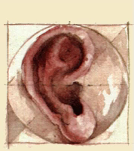
Sound is produced by vibrating objects, such as the vocal cords in your throat.
These vibrating objects cause the particles in the surrounding medium to vibrate as well.
Our ears are able to transform vibrations in the air, or sounds, into a signal that our brains can understand.

Slide 6
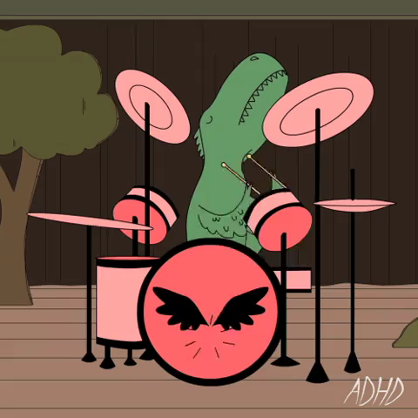
Music is the combination of sounds, or vibrations.
A musical instrument is a device used to make sound. It is thought that the first musical instruments were used to mimic natural sounds, like a bird call or thunder.

Slide 7

Some instruments are steeped in tradition.
Australian Aboriginals make music using some of the oldest instruments in the world. To build their musical instruments, they use common resources from the natural environment.

Slide 8

Aboriginal instruments can be split into three groups.
These groups are based on the way instruments create vibrations to make sound.
The three groups include:
Aerophones
Idiophones
Membranophones

Slide 9
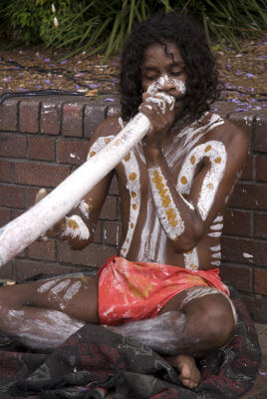
Aerophones produce sound through the vibration of a body of air.
The instrument itself does not vibrate.
An example of an aerophone is a didgeridoo.

Slide 10
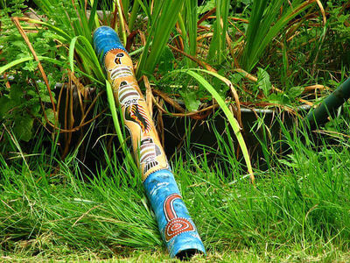
Didgeridoos are aerophones.
Didgeridoos are made from long tree branches, hollowed out by termites. They are usually cut to around 1.5 m in length and are slightly wider at one end. The narrow end that is blown into is sealed with a rim of beeswax.
To create the famous drone of the didgeridoo, the player vibrates their lips as they breathe into the instrument. The technique of circular breathing, or constantly breathing in through the nose and pushing air out of the mouth, provides a constant supply of air and vibrations.

Slide 11
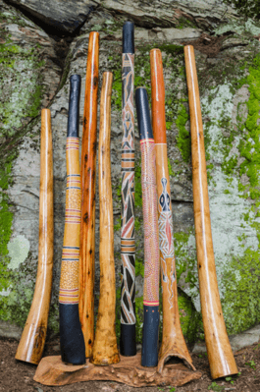
Aerophones make sound by vibrating air.
The vibration of the lips and the breath cause air particles to move around inside the instrument at different frequencies, which determines the pitch of the drone.
The pitch is also controlled by the length of the didgeridoo - the longer the didgeridoo, the lower the pitch.

Slide 12
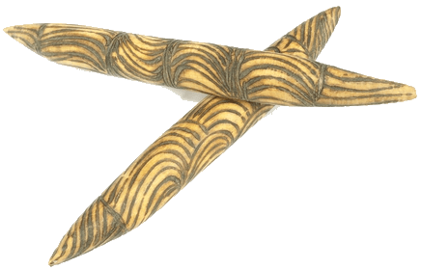
Idiophones produce sound through vibrations in the actual instrument itself.
Idiophones are made up of two pieces and can be struck, rubbed, shaken or plucked to produce vibrations. They are normally used for percussion.
Clapsticks are an example of an idiophone.

Slide 13
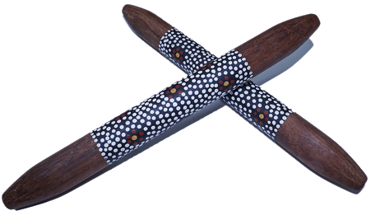
Clapsticks are two wooden sticks used for percussive rhythm.
The bottom stick is held flat in the hand. The top stick is brought down quickly and cleanly on the bottom stick to make a sharp sound. Boomerangs can be used as clapsticks.
The bottom stick vibrates when it is struck by the top stick. The vibrations in the bottom stick are passed into the air molecules around the stick to make a clear, loud sound.

Slide 14
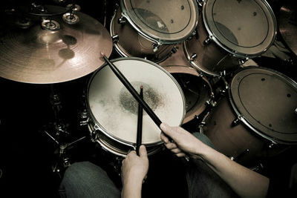
Membranophones produce sound through vibrations in a stretched membrane.
The membrane can be struck with a hand or a stick to create vibrations.
An example of a membranophone is a drum.

Slide 15
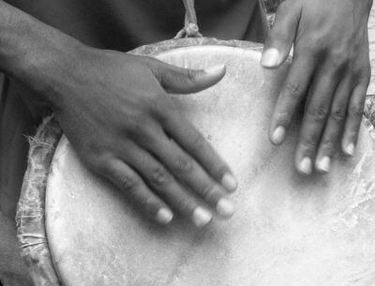
A skin drum is a membranophone.
A skin drum is made up of a hollow hourglass shaped drum with skin stretched over one opening. The skin is usually goanna or lizard. The skin of the drum is hit with a hand or a stick, causing it to vibrate and move the air inside the body of the drum.

Slide 16

The pitch of the sound is determined by the size of the drum and how tight the skin is stretched.
A small drum with tightly stretched skin vibrates more often when hit, resulting in a higher frequency sound wave and a higher pitch. A large drum with loosely stretched skin vibrates less often when hit, resulting in a lower frequency sound wave and a lower pitch.

Slide 17


